Slide 1

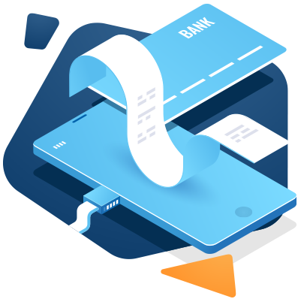

Spring Security: OAuth2 Integration
Presenting to: Opus Technologies
09-May-2024
Anand Kane

Slide 2


Agenda
Introduction to OAuth2
OAuth2 grant types
Components of OAuth2 authorization flow
JSON Web Token (JWT)
Refresh tokens
Apply authorization in Spring Boot service
Brief introduction to OpenID Connect (OIDC)
Q&A

Slide 3
You Have Used OAuth2
When a web application allows users to login with Google, Facebook, GitHub etc.
That application leverages the user management, authentication, and authorization provided by these external systems.
In such cases, Google, Facebook, GitHub are the OAuth2 Servers (Authorization Servers).
And they are also Resource Servers.
Let’s get formally introduced to OAuth2 and various components of OAuth2 in the following few slides…
Notes:
Please use these blocks and resize as per your need . Do not alter colours and thickness

Slide 4
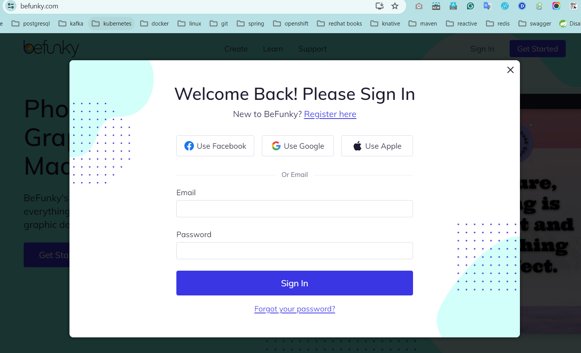
You Have Used OAuth2
Notes:
Please use these blocks and resize as per your need . Do not alter colours and thickness

Slide 5
You Have Used OAuth2
This is the client application
It wants to access resources on behalf of the user (resource owner)
It redirects user to the authorization server for authentication
Notes:
Please use these blocks and resize as per your need . Do not alter colours and thickness

Slide 6
You Have Used OAuth2
These are the OAuth2 compliant authorization servers
User selects one of them to authenticate itself and authorize client application to access resources on its behalf
Authorization server hands over a token (typically JWT) to client application after successful authentication, which it presents to the resource server for authorization.
Notes:
Please use these blocks and resize as per your need . Do not alter colours and thickness

Slide 7
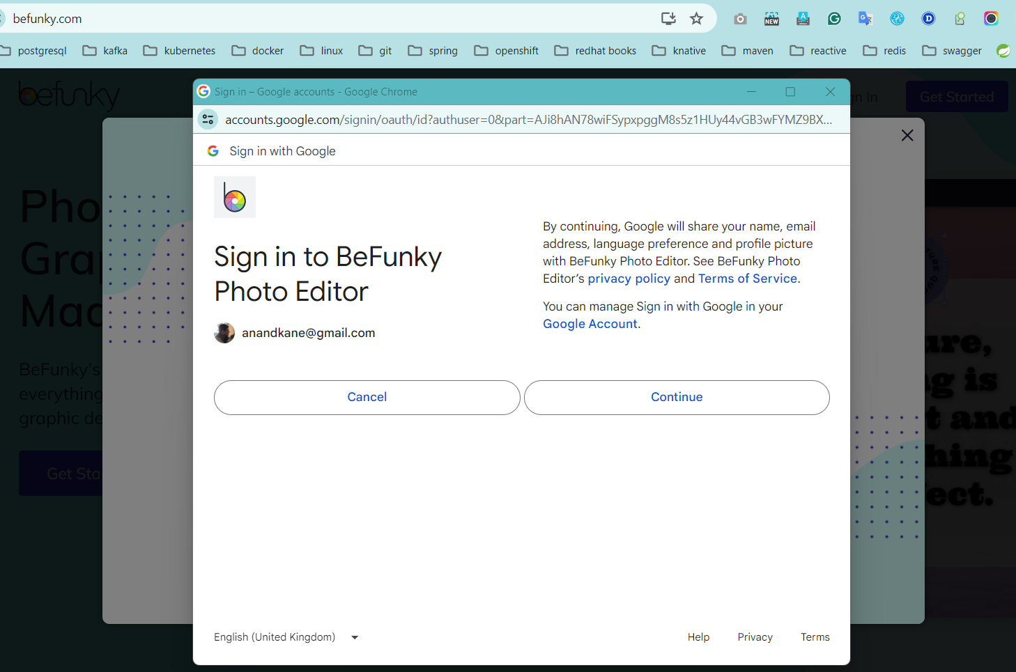
You Have Used OAuth2
Notes:
Please use these blocks and resize as per your need . Do not alter colours and thickness

Slide 8
You Have Used OAuth2
This is the user (Resource Owner) whose resources are accessed by the client application on its behalf.
Notes:
Please use these blocks and resize as per your need . Do not alter colours and thickness

Slide 9
You Have Used OAuth2
These are the resources owned by the user
Notes:
Please use these blocks and resize as per your need . Do not alter colours and thickness

Slide 10
Few More Examples
Resource Owner | OAuth Server | Resources | Resource Server
Tweeter user | Tweeter | Tweets, Retweets, Comments | Tweeter
Google user | Google | Docs, Photos, Profile picture etc. | Google
Facebook user | Facebook | Profile picture, Posts, Comments, Photos, Videos etc. | Facebook
GitHub user | GitHub | Repositories etc. | GitHub
Okta user | Okta | Custom/Okta resources | Custom application/Okta
Keycloak user | Keycloak | Custom resources | Custom application
In case of public OAuth providers, a provider is both, Authorization and Resource Server.
However, they can be used for authorizing resources in custom applications (a monolith or Microservices based backend application).
Enterprise application that do not want to use public OAuth providers can deploy one of the commercial OAuth providers like Okta, Keycloak, AWS Cognito etc.
They can even write their own OAuth server. Spring Boot comes with built in support for creating OAuth server.
Notes:
Please use these blocks and resize as per your need . Do not alter colours and thickness

Slide 11
What is OAuth2
OAuth2
Is an abbreviation of Open Authorization and 2 is the version (OAuth 2.0).
Is a standard that allows client applications (web app, mobile app, desktop app) to access resources of another application(s) (typically backend) on behalf of a user.
Allows such an access without requiring user to share their credentials with client apps.
Uses token-based authorization (typically JWT).
Provides authorization support for services to access each other's resources in Microservices based applications.
Allows to implement authentication and authorization into an independent service.
Notes:
Please use these blocks and resize as per your need . Do not alter colours and thickness

Slide 12
Benefits of Independent Authorization Service
Allows authorization service to scale independently.
Follows Single Responsibility Principle.
Avoids duplication of user management in individual services.
Removes the responsibility of setting, storing, and managing passwords which is frequently associated with credential-based data breaches.
Facilitates Single Sign On (SSO). A user once authenticated by an Authorization Server, does not require authentication for every client app until logged out for any reason.
Notes:
Please use these blocks and resize as per your need . Do not alter colours and thickness

Slide 13
Authorization Flow: Demo Application Setup
We have the below set up to understand the authorization flow
Locally running Keycloak in dev mode as OAuth2 server.
A Spring Boot backend RESTful Customer Service with basic CRUD operations.
This service acts as a Resource Server and customers are the resources.
Resource owners are the users created in Keycloak.
Postman is used as a client application to make REST calls to Customer Service.
Notes:
Please use these blocks and resize as per your need . Do not alter colours and thickness

Slide 14
Authorization Flow: Steps involved
Postman wants to perform one or more operations on Customer resource(s).
It redirects the user (resource owner) to Keycloak login page for authentication.
User inputs the credentials and, if authenticated, the client is given a short lived one time use auth code.
Client makes a REST call to the ‘token’ end point of the OAuth2 server to get the authorization token.
Client includes the token in calls it makes to the resource server. The token contains necessary authorization information used by resource server to check authorization.
How does resource server verify authenticity of the token?
For opaque tokens, it calls the ‘introspection’ endpoint of the OAuth server.
Non-opaque tokens (typically JWT) contain signature.
Signature is created using the claims in the token.
It can be decrypted by the public key the resource server receives from the OAuth server.
If the claims are altered in any way, the token is rejected, and any access is denied.
Notes:
Please use these blocks and resize as per your need . Do not alter colours and thickness

Slide 15
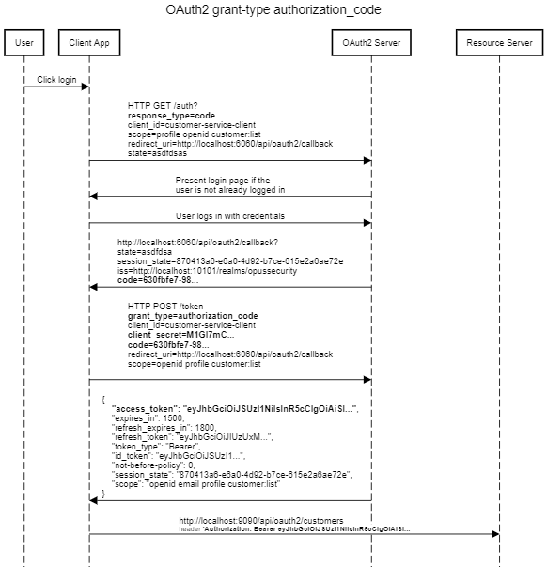
Authorization Flow: Sequence Diagram
User clicks the login link or attempts accessing a protected resource.
Client app makes a GET request on the ‘auth’ endpoint of the OAuth2 server if it doesn’t already have access token.
OAuth2 server authenticates user (if not already logged in).
Notes:
Please use these blocks and resize as per your need . Do not alter colours and thickness

Slide 16
Authorization Flow: Sequence Diagram
OAuth2 server redirects to the redirect-uri provided by client app.
If user authentication is successful, auth code is included in the redirection.
Notes:
Please use these blocks and resize as per your need . Do not alter colours and thickness

Slide 17
Authorization Flow: Sequence Diagram
Client app makes a POST request to the ‘token’ endpoint of OAuth2 server.
It includes the client_secret in the request to authenticate itself.
OAuth2 server returns access token to the client.
Notes:
Please use these blocks and resize as per your need . Do not alter colours and thickness

Slide 18
Authorization Flow: Sequence Diagram
Client app uses token to access resources on the resource server.
Resource server validates authenticity of the token and permits or rejects access.
Notes:
Please use these blocks and resize as per your need . Do not alter colours and thickness

Slide 19
Authorization Flow: Demo
Demo
Notes:
Please use these blocks and resize as per your need . Do not alter colours and thickness

Slide 20
Authorization Flow: PKCE (Proof Key for Code Exchange)
Advanced version of authorization_code grant type with enhanced security.
Designed originally for the client apps that cannot securely store client secret e.g. JavaScript single page apps.
A code_challenge string is included in the GET request to get auth code.
A code_verifier string is included in the POST request to get token.
code_challenge is the SHA-256 hash of the code_verifier. The hash is irreversible and hence it is not possible to get code_verifier back from the code_challenge.
This way, OAuth2 server can ensure that the client who asked for auth code is the one asking for auth token.
code_verifier is Proof Key used to Exchange auth Code for auth token.
code_verifier and code_challenge can be generated programmatically.
It’s a good practice to use unique and random code_verifier for each request.
Notes:
Please use these blocks and resize as per your need . Do not alter colours and thickness

Slide 21
Authorization Flow: PKCE (Proof Key for Code Exchange)
HTTP GET /auth?
response_type=code&
client_id=customer-service-client&
scope=profile openid customer:list&
redirect_uri=http://localhost:6060/api/oauth2/callback&
state=asdfdsas&
code_challenge_method=S256&
code_challenge=ZGUDKjM-X1qnKXLwf2xd1ZJkE8b48vvZJR1qs-0C_q8
HTTP POST /token
grant_type=authorization_code
client_id=customer-service-client
client_secret=M1GI7mComhmw2vS6aVk0aMKAjvwctO4t
code=66e9d10b-9269-4…
redirect_uri=http://localhost:6060/api/oauth2/callback
scope=openid profile customer:list
code_verifier=YZ8bz7XDJG38ixtgfLY3_Ik27OYlYi7Fe8owg7ejZgw
Notes:
Please use these blocks and resize as per your need . Do not alter colours and thickness

Slide 22
OpenID Connect (OIDC)
OpenID Connect (OIDC) is an identity layer built on top of the OAuth 2.0 framework and uses JSON Web Tokens (typically JWTs) to complete the authentication and authorization processes.
It allows users to access multiple sites with a single set of credentials.
An OIDC compliant server is called as an Identity Provider (IP).
Facilitates Single Sign On (SSO). A user once authenticated with an IP, does not require authentication for every client app until logged out for any reason.
OIDC verifies a user's identity to a client service, also called a Relying Party, which can be a web application, JavaScript application, or mobile app.
It removes the responsibility of setting, storing, and managing passwords which is frequently associated with credential-based data breaches.
OIDC provides authentication, which verifies that users are who they say they are, while OAuth 2.0 authorizes which systems those users are allowed to access.
Notes:
Please use these blocks and resize as per your need . Do not alter colours and thickness

Slide 23



Q & A
Thank You.
2500 Northwinds Pkwy, Suite 630, Alpharetta 30009
@opusconsultingsolutions
https://www.opusconsulting.com/
@consultopus

